Slide 1
LOWER SIXTH ARTS
GEOGRAPHY
Lesson 11
Management of Water Resources in Cameroon
Notes:
Good morning, class, and welcome to our geography lesson. I am your geography teacher, Mr Kamdem. Today we are starting Lesson 11: Management of Water Resources in Cameroon.

Slide 2
CLASS INFO
Class, Chapter and Duration
Class | Lower Sixth Arts
Chapter | Geography of Cameroon
Duration | 2 periods (2 × 50 minutes)
Notes:
This lesson is for Lower Sixth Arts. It belongs to Geography of Cameroon. We shall need 2 periods to cover it.

Slide 3
IDENTIFICATION
Lesson Identification
Topic | Geography of Cameroon
Sub-topic | Economic Activities and Development of Cameroon
Lesson | Lesson 11: Management of Water Resources in Cameroon
Notions / Concepts | Water resources, fishing, aquaculture, irrigation scheme, flood-retreat cultivation, navigation, hydroelectric power, water supply.
Syllabus focus | Distribution of water bodies and their resources; use for fishing (modern and traditional), agriculture (irrigation schemes and flood-retreat cultivation), transport, water supply, sand extraction and hydroelectric power; problems, solutions and impacts.
Competence | Learners are able to describe the uses of the water resources of Cameroon and propose solutions to the problems of their management.
Notes:
Our topic is Geography of Cameroon, and the sub-topic is Economic Activities and Development of Cameroon. The key notions we shall use today are: water resources, fishing, aquaculture, irrigation scheme, flood-retreat cultivation, navigation, hydroelectric power, water supply. At the end, you should be able to do this: learners are able to describe the uses of the water resources of Cameroon and propose solutions to the problems of their management.

Slide 4

HOMEWORK CORRECTION
Correction of the Homework
Question (Lesson 10: Management of Mineral and Energy Resources in Cameroon):
Name the dam built on the Benue.
Notes:
Before we start the new lesson, let us correct the homework I gave you at the end of Lesson 10: Management of Mineral and Energy Resources in Cameroon. The question was: Name the dam built on the Benue. Take out your exercise books.

Slide 5
HOMEWORK CORRECTION
Correction: Possible Answer
The Lagdo dam.
Notes:
Here is a good answer. The Lagdo dam. Compare it with your own answer and correct your work in red.

Slide 6
LESSON PLAN
Lesson Plan
Correction of the homework
Objectives and recall
Real-life situation and action to take
Learning activities
Board summary
Evaluation, remediation and homework
Notes:
Here is the plan of our lesson today. First, we shall correct the homework. Then we shall look at the objectives and recall what you already know. After that, we shall study a situation from real life and the action to take, and do the learning activities. Finally, we shall copy the board summary, do the evaluation and the remediation, and I will give you the homework.

Slide 7
OBJECTIVES
Objectives
By the end of this lesson, you should be able to:
Describe the distribution of water bodies and their resources.
Explain the use of water for fishing and agriculture, with their problems and solutions.
Notes:
Take your time to copy this part; we will continue together.

Slide 8
OBJECTIVES
Objectives (continued)
Explain the use of water for transport, water supply and other uses.
Describe the hydroelectric sites, their problems and solutions.
Notes:
By the end of this lesson, you should be able to do four things. Number 1: describe the distribution of water bodies and their resources. Number 2: explain the use of water for fishing and agriculture, with their problems and solutions. Number 3: explain the use of water for transport, water supply and other uses. Number 4: describe the hydroelectric sites, their problems and solutions.

Slide 9
PREVIOUS KNOWLEDGE
Previous Knowledge
The Lagdo dam is on the Benue.
The Sanaga has the largest dams of Cameroon.
SEMRY grows rice with water from the Logone.
Notes:
Let us first remember what you already know. The Lagdo dam is on the Benue. The Sanaga has the largest dams of Cameroon. SEMRY grows rice with water from the Logone. Keep this in mind, because we shall build on it today.

Slide 10
REAL-LIFE SITUATION
Situation in Real Life
Hamadou visits his uncle, a fisherman on the Lagdo reservoir.
The uncle complains that his catches are smaller and that the water level is low, which reduces the water in his irrigation channels.
Notes:
Take your time to copy this part; we will continue together.

Slide 11
REAL-LIFE SITUATION
Situation in Real Life (continued)
That evening the electricity goes off, and a neighbour says: "It is the low water at the dam again."
Hamadou asks: "How is one lake used for so many things, and how can we manage it better?"
Notes:
Listen carefully to this situation from real life. Hamadou visits his uncle, a fisherman on the Lagdo reservoir. The uncle complains that his catches are smaller and that the water level is low, which reduces the water in his irrigation channels. That evening the electricity goes off, and a neighbour says: "It is the low water at the dam again." Hamadou asks: "How is one lake used for so many things, and how can we manage it better?" Think about it, because I am going to ask you some questions.

Slide 12
REAL-LIFE SITUATION
Situation: Question 1
What is the problem in the situation?
Notes:
Question 1: What is the problem in the situation? Think for a moment, then raise your hand to answer.

Slide 13
REAL-LIFE SITUATION
Answer
The Lagdo reservoir serves many uses, and low water affects them all; Hamadou wants to know how to manage it better.
Notes:
Good. The Lagdo reservoir serves many uses, and low water affects them all; Hamadou wants to know how to manage it better.

Slide 14
REAL-LIFE SITUATION
Situation: Question 2
Name three uses of the Lagdo reservoir in the situation.
Notes:
Question 2: Name three uses of the Lagdo reservoir in the situation. Think for a moment, then raise your hand to answer.

Slide 15
REAL-LIFE SITUATION
Answer
Fishing, irrigation and electricity.
Notes:
Good. Fishing, irrigation and electricity.

Slide 16
REAL-LIFE SITUATION
Situation: Question 3
Why does the electricity go off?
Notes:
Question 3: Why does the electricity go off? Think for a moment, then raise your hand to answer.

Slide 17
REAL-LIFE SITUATION
Possible Answer
The water level at the dam is low, so less electricity is produced.
Notes:
Good. The water level at the dam is low, so less electricity is produced.

Slide 18
ACTION TO TAKE
Action to Take
Save water and electricity, and protect rivers and lakes from pollution.
Notes:
From this situation, the action we are working towards in this lesson is the following: save water and electricity, and protect rivers and lakes from pollution.

Slide 19
JUSTIFICATION
Justification of the Lesson
This lesson helps us to understand the value of water resources for food, energy and transport, and the need to manage them carefully.
Notes:
Why is this lesson important for you? This lesson helps us to understand the value of water resources for food, energy and transport, and the need to manage them carefully.

Slide 20
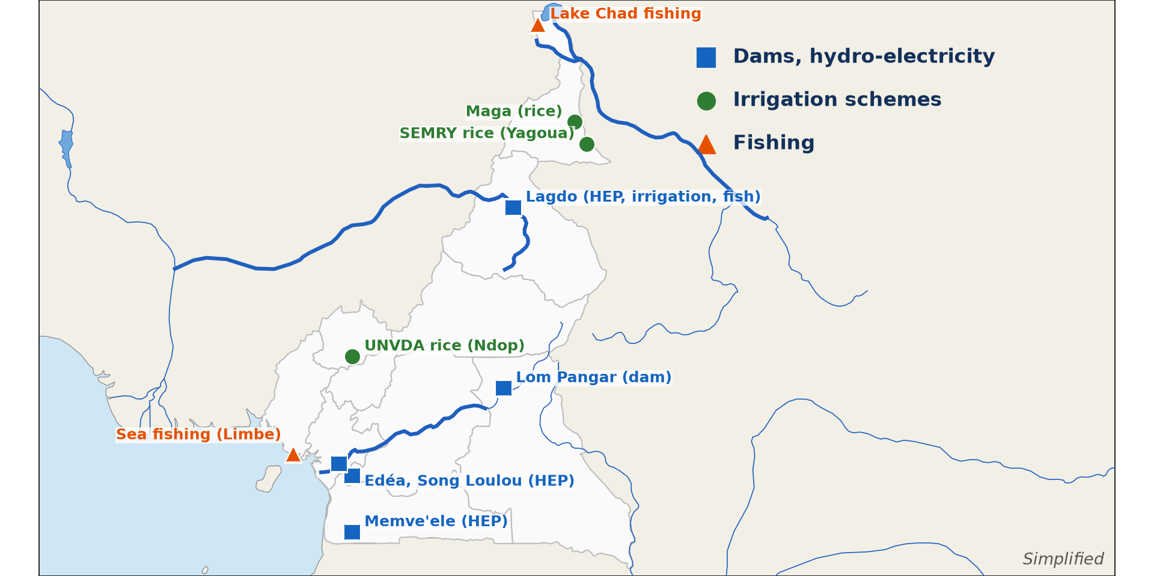
1. DISTRIBUTION
Activity 1
Water resources of Cameroon.
Notes:
Activity 1. Look carefully at this diagram: water resources of Cameroon. Observe every detail before I ask the question.

Slide 21
1. DISTRIBUTION
Activity 1: Question
Name one large irrigation scheme of the Far North.
Notes:
Here is the question for Activity 1: Name one large irrigation scheme of the Far North. Take one minute to think and write your answer in your rough notebook.

Slide 22
1. DISTRIBUTION
Activity 1: Answer
SEMRY (rice, near Yagoua and Maga).
Notes:
Let us check the answer together. SEMRY (rice, near Yagoua and Maga).

Slide 23

2. FISHING
Activity 2
Fishermen in canoes.
Notes:
Activity 2. Look carefully at this picture: fishermen in canoes. Observe every detail before I ask the question.

Slide 24
2. FISHING
Activity 2: Question
What is the difference between artisanal and industrial fishing?
Notes:
Here is the question for Activity 2: What is the difference between artisanal and industrial fishing? Take one minute to think and write your answer in your rough notebook.

Slide 25
2. FISHING
Activity 2: Answer
Artisanal fishing uses canoes and nets; industrial fishing uses large motorised trawlers.
Notes:
Let us check the answer together. Artisanal fishing uses canoes and nets; industrial fishing uses large motorised trawlers.

Slide 26

3. AGRICULTURE
Activity 3
An irrigated rice field.
Notes:
Activity 3. Look carefully at this picture: an irrigated rice field. Observe every detail before I ask the question.

Slide 27
3. AGRICULTURE
Activity 3: Question
Why is irrigation important in the North?
Notes:
Here is the question for Activity 3: Why is irrigation important in the North? Take one minute to think and write your answer in your rough notebook.

Slide 28
3. AGRICULTURE
Activity 3: Answer
It allows farming during the long dry season.
Notes:
Let us check the answer together. It allows farming during the long dry season.

Slide 29

4. TRANSPORT AND OTHER USES
Activity 4
The Wouri estuary.
Notes:
Activity 4. Look carefully at this picture: the Wouri estuary. Observe every detail before I ask the question.

Slide 30
4. TRANSPORT AND OTHER USES
Activity 4: Question
Why is the Wouri estuary important for Cameroon?
Notes:
Here is the question for Activity 4: Why is the Wouri estuary important for Cameroon? Take one minute to think and write your answer in your rough notebook.

Slide 31
4. TRANSPORT AND OTHER USES
Activity 4: Answer
It gives access to the port of Douala, the main port of the country.
Notes:
Let us check the answer together. It gives access to the port of Douala, the main port of the country.

Slide 32

5. HYDROELECTRIC POWER
Activity 5
The Lagdo dam.
Notes:
Activity 5. Look carefully at this picture: the Lagdo dam. Observe every detail before I ask the question.

Slide 33
5. HYDROELECTRIC POWER
Activity 5: Question
Which regions receive electricity from the Lagdo dam?
Notes:
Here is the question for Activity 5: Which regions receive electricity from the Lagdo dam? Take one minute to think and write your answer in your rough notebook.

Slide 34
5. HYDROELECTRIC POWER
Activity 5: Answer
The North, the Far North and the Adamawa.
Notes:
Let us check the answer together. The North, the Far North and the Adamawa.

Slide 35
BOARD SUMMARY
Board Summary
Topic: Geography of Cameroon
Sub-topic: Economic Activities and Development of Cameroon
Lesson 11: Management of Water Resources in Cameroon
Notes:
Now we are going to copy the board summary. Write the title and the headings neatly in your notebooks. I will give you enough time for each slide, so do not rush.

Slide 36
BOARD SUMMARY
DEFINITIONS
The key terms of this lesson are defined as follows:
Water resources: They are the water bodies of a country (sea, rivers, lakes, underground water) and what they provide.
Irrigation: It is the artificial supply of water to crops.
Notes:
Let us copy the definitions. The key terms of this lesson are defined as follows. On this slide we have Water resources and Irrigation. Write each point on a new line, with the key term first, and explain it in your own words when we revise. When you finish, we go to the next slide.

Slide 37
BOARD SUMMARY
DEFINITIONS (continued)
Flood-retreat cultivation: It is farming on land left moist when river floods go down.
Aquaculture: It is the rearing of fish in ponds or cages.
Notes:
We continue with the definitions. On this slide we have Flood-retreat cultivation and Aquaculture. Write each point on a new line, with the key term first, and explain it in your own words when we revise.

Slide 38
BOARD SUMMARY
1. Distribution of Water Bodies and their Resources
The water bodies of Cameroon and their resources are the following:
The sea: The Atlantic coast, about 400 km long, provides fish, shrimps, oil and gas. It also has the ports of the country and beaches for tourism.
Illustration: the water resources of Cameroon
Notes:
Let us copy Distribution of Water Bodies and their Resources. The water bodies of Cameroon and their resources are the following. Copy the point on The sea on the left, then draw the diagram on the right: the water resources of Cameroon. Give it a title and label it clearly.

Slide 39
BOARD SUMMARY
1. Distribution of Water Bodies and their Resources
Rivers: The Sanaga, the Wouri, the Nyong, the Ntem, the Benue and the Logone provide water, fish, energy and transport. Sand is also dredged from their beds for building.
Notes:
We continue with Distribution of Water Bodies and their Resources. Copy the point on Rivers: write the key term first, then its explanation.

Slide 40
BOARD SUMMARY
1. Distribution of Water Bodies and their Resources
Lakes: Cameroon has Lake Chad, crater lakes such as Barombi Mbo, Nyos and Ossa, and reservoirs such as Lagdo, Maga, Mbakaou and Lom Pangar. They supply fish, water and energy.
Notes:
We continue with Distribution of Water Bodies and their Resources. Copy the point on Lakes: write the key term first, then its explanation.

Slide 41
BOARD SUMMARY
1. Distribution of Water Bodies and their Resources
Underground water: Aquifers supply boreholes and wells in towns and villages. They are especially important in the north, where rivers dry up in the dry season.
Notes:
We continue with Distribution of Water Bodies and their Resources. Copy the point on Underground water: write the key term first, then its explanation.

Slide 42
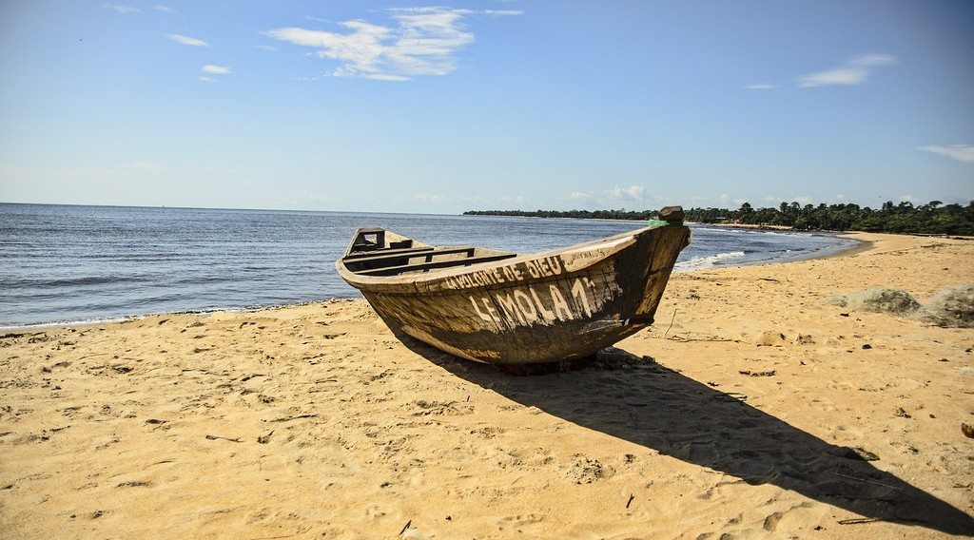
BOARD SUMMARY
2. Use for Fishing
A) Methods of Fishing
Fishing is carried out by the following methods:
Modern large-scale fishing: Motorised trawlers from Douala, Limbe and Kribi catch fish and shrimps at sea. They use large nets and keep the catch in cold stores.
Illustration: a fishing trawler
Notes:
Let us copy Methods of Fishing. Fishing is carried out by the following methods. Copy the point on Modern large-scale fishing on the left, then draw the diagram on the right: a fishing trawler. Give it a title and label it clearly.

Slide 43
BOARD SUMMARY
2. Use for Fishing
A) Methods of Fishing
Traditional small-scale fishing: Fishermen use canoes, nets, lines and traps on rivers, lakes and along the coast. This fishing supplies most of the fish eaten locally.
Illustration: fishing canoes
Notes:
Copy the point on Traditional small-scale fishing on the left, then draw the diagram on the right: fishing canoes. Give it a title and label it clearly.

Slide 44
BOARD SUMMARY
2. Use for Fishing
A) Methods of Fishing
Main inland fisheries: Lake Chad, the Lagdo and Maga reservoirs and the floodplains of the Logone are the main inland fishing areas. Their fish is smoked or dried and sold in the towns of the north and in Nigeria.
Notes:
We continue with Methods of Fishing. Copy the point on Main inland fisheries: write the key term first, then its explanation.

Slide 45
BOARD SUMMARY
2. Use for Fishing
A) Methods of Fishing
Aquaculture: Fish farms and ponds are developing, especially in the Centre and the West. They produce tilapia and catfish and reduce the pressure on wild fish.
Notes:
We continue with Methods of Fishing. Copy the point on Aquaculture: write the key term first, then its explanation.

Slide 46
BOARD SUMMARY
2. Use for Fishing
B) Problems and Solutions
Fishing faces the following problems, which are solved in the following ways:
Overfishing and illegal nets: Too many fishermen and nets with very small meshes catch young fish before they can breed. As a result, fish stocks are falling in many lakes and rivers.
Notes:
Let us copy Problems and Solutions. Fishing faces the following problems, which are solved in the following ways. Copy the point on Overfishing and illegal nets: write the key term first, then its explanation.

Slide 47
BOARD SUMMARY
2. Use for Fishing
B) Problems and Solutions
Pollution and the shrinking of Lake Chad: Waste from towns and industries pollutes the water, and Lake Chad has shrunk greatly. Poor conservation and storage also cause fish to rot.
Notes:
We continue with Problems and Solutions. Copy the point on Pollution and the shrinking of Lake Chad: write the key term first, then its explanation.

Slide 48
BOARD SUMMARY
2. Use for Fishing
B) Problems and Solutions
Fishing rules and control: Rules fix the size of nets and closed seasons when fishing is forbidden. MINEPIA controls fishermen and seizes illegal nets.
Notes:
We continue with Problems and Solutions. Copy the point on Fishing rules and control: write the key term first, then its explanation.

Slide 49
BOARD SUMMARY
2. Use for Fishing
B) Problems and Solutions
Cold storage and aquaculture: Cold stores and improved smoking ovens reduce the loss of fish. Aquaculture increases production without emptying rivers and lakes.
Notes:
We continue with Problems and Solutions. Copy the point on Cold storage and aquaculture: write the key term first, then its explanation.

Slide 50
BOARD SUMMARY
2. Use for Fishing
C) Impacts
Fishing has the following impacts:
Socio-economic impacts: Fishing gives jobs to fishermen, fish sellers and boat builders. It supplies cheap protein to the population.
Notes:
Let us copy Impacts. Fishing has the following impacts. Copy the point on Socio-economic impacts: write the key term first, then its explanation.

Slide 51
BOARD SUMMARY
2. Use for Fishing
C) Impacts
Environmental impacts: Overfishing reduces fish stocks and the diversity of species. Mangroves are cut to provide wood for smoking fish.
Notes:
We continue with Impacts. Copy the point on Environmental impacts: write the key term first, then its explanation.

Slide 52
BOARD SUMMARY
3. Use for Agriculture
Water is used for agriculture in the following ways:
SEMRY: SEMRY runs large irrigated rice schemes on the Logone near Yagoua and Maga in the Far North. Water from the Maga reservoir and the Logone allows two harvests a year.
Illustration: a rice field
Notes:
Let us copy Use for Agriculture. Water is used for agriculture in the following ways. Copy the point on SEMRY on the left, then draw the diagram on the right: a rice field. Give it a title and label it clearly.

Slide 53
BOARD SUMMARY
3. Use for Agriculture
Lagdo and UNVDA: Farmers grow irrigated rice and other crops around the Lagdo reservoir on the Benue. In the North-West, UNVDA irrigates rice in the Ndop plain.
Notes:
We continue with Use for Agriculture. Copy the point on Lagdo and UNVDA: write the key term first, then its explanation.

Slide 54
BOARD SUMMARY
3. Use for Agriculture
Flood-retreat cultivation: When the floods of the Logone and the Benue go down, farmers plant dry-season sorghum (muskwari), maize and vegetables on the moist land. This gives food during the dry season.
Notes:
We continue with Use for Agriculture. Copy the point on Flood-retreat cultivation: write the key term first, then its explanation.

Slide 55
BOARD SUMMARY
3. Use for Agriculture
Benefits and problems: Irrigation produces more food and gives jobs in the dry season. However, it is costly, and canals silt up while waterlogging, salinity and conflicts over water appear.
Notes:
We continue with Use for Agriculture. Copy the point on Benefits and problems: write the key term first, then its explanation.

Slide 56
BOARD SUMMARY
4. Use for Transport and Other Purposes
Water is used for transport and other purposes in the following ways:
Sea transport: The ports of Douala, Kribi (a deep-sea port) and Limbe handle almost all the foreign trade of Cameroon. Douala also serves Chad and the Central African Republic.
Illustration: the Wouri
Notes:
Let us copy Use for Transport and Other Purposes. Water is used for transport and other purposes in the following ways. Copy the point on Sea transport on the left, then draw the diagram on the right: the Wouri. Give it a title and label it clearly.

Slide 57
BOARD SUMMARY
4. Use for Transport and Other Purposes
River transport: The Benue is navigable to Garoua only from about August to October. The Sangha is used for transport in the south-east.
Notes:
We continue with Use for Transport and Other Purposes. Copy the point on River transport: write the key term first, then its explanation.

Slide 58
BOARD SUMMARY
4. Use for Transport and Other Purposes
Water supply: CAMWATER treats river and underground water and supplies it to towns such as Douala, Yaoundé and Garoua. Industries also use large amounts of water.
Notes:
We continue with Use for Transport and Other Purposes. Copy the point on Water supply: write the key term first, then its explanation.

Slide 59
BOARD SUMMARY
4. Use for Transport and Other Purposes
Sand extraction: Sand is dredged from the Wouri, the Sanaga and the Benue for building. It supplies the construction industry of the towns.
Notes:
We continue with Use for Transport and Other Purposes. Copy the point on Sand extraction: write the key term first, then its explanation.

Slide 60

BOARD SUMMARY
5. Use for Hydroelectric Power
A) The Hydroelectric Sites
Hydroelectricity is produced at the following sites:
Southern sites: Song Loulou and Edéa on the Sanaga, Nachtigal (420 MW) and Memve'ele on the Ntem supply the southern grid. This grid serves the Littoral, Centre, South, West and East Regions.
Illustration: the Nachtigal dam
Notes:
Let us copy The Hydroelectric Sites. Hydroelectricity is produced at the following sites. Copy the point on Southern sites on the left, then draw the diagram on the right: the Nachtigal dam. Give it a title and label it clearly.

Slide 61
BOARD SUMMARY
5. Use for Hydroelectric Power
A) The Hydroelectric Sites
The northern site: The Lagdo dam (72 MW) on the Benue supplies the North, the Far North and the Adamawa. It is the only large dam of the northern grid.
Illustration: Lake Lagdo
Notes:
Copy the point on The northern site on the left, then draw the diagram on the right: lake Lagdo. Give it a title and label it clearly.

Slide 62
BOARD SUMMARY
5. Use for Hydroelectric Power
A) The Hydroelectric Sites
Regulating dams: Lom Pangar, Mbakaou, Bamendjin and Mapé store water in the rainy season. They release it in the dry season to keep the Sanaga flowing through the power stations.
Notes:
We continue with The Hydroelectric Sites. Copy the point on Regulating dams: write the key term first, then its explanation.

Slide 63
BOARD SUMMARY
5. Use for Hydroelectric Power
B) Problems and Solutions
Hydroelectricity faces the following problems, which are solved in the following ways:
Problems: Low water in the dry season, silting of reservoirs, weeds, old equipment and weak grids cause power cuts called load shedding. The northern grid is not linked to the southern one.
Notes:
Let us copy Problems and Solutions. Hydroelectricity faces the following problems, which are solved in the following ways. Copy the point on Problems: write the key term first, then its explanation.

Slide 64
BOARD SUMMARY
5. Use for Hydroelectric Power
B) Problems and Solutions
Solutions: New dams are being built, reservoirs are dredged and catchments are protected against erosion. The northern and southern grids are to be linked, and solar energy is being developed in the north.
Notes:
We continue with Problems and Solutions. Copy the point on Solutions: write the key term first, then its explanation.

Slide 65
FORMATIVE EVALUATION
Evaluation 1
Name two irrigation schemes of Cameroon.
Notes:
Now let us check what you have understood. Question 1: Name two irrigation schemes of Cameroon. Answer in your exercise book.

Slide 66
FORMATIVE EVALUATION
Expected Answer
SEMRY (Logone) and UNVDA (Ndop); also Lagdo.
Notes:
The expected answer is: sEMRY (Logone) and UNVDA (Ndop); also Lagdo. If you got it right, well done.

Slide 67
FORMATIVE EVALUATION
Evaluation 2
Give two problems of hydroelectric production and one solution.
Notes:
Now let us check what you have understood. Question 2: Give two problems of hydroelectric production and one solution. Answer in your exercise book.

Slide 68
FORMATIVE EVALUATION
Expected Answer
Low water in the dry season and silting; building regulating dams (or dredging).
Notes:
The expected answer is: low water in the dry season and silting; building regulating dams (or dredging). If you got it right, well done.

Slide 69
REMEDIATION
Remediation
Fill in the blanks:
Farming on moist land left by floods is ______ cultivation.
The dam that supplies the north is ______.
The state company that supplies drinking water is ______.
Notes:
For those who need more practice, fill in the blanks in your exercise book. The answers are: number 1, flood-retreat; number 2, Lagdo; number 3, CAMWATER.

Slide 70
HOMEWORK
Homework
Name one factory in Garoua and what it produces.
Notes:
For your homework: Name one factory in Garoua and what it produces. We shall correct it at the beginning of our next lesson.

Slide 71
NEXT LESSON
Next Lesson
Our next lesson will be on:
Lesson 12: Industrial Development and Change in Cameroon
Notes:
Our next lesson will be on Lesson 12: Industrial Development and Change in Cameroon. Thank you for your attention, and see you next time.

Slide 72
BILINGUAL GAME
Bilingual Game (Jeu Bilingue)
English | Français
Water resources | Les ressources en eau
Fishing | La pêche
Irrigation | L'irrigation
Dam | Le barrage
Reservoir | La retenue
Navigation | La navigation
Power cut | La coupure d'électricité
Drinking water | L'eau potable
Notes:
Let us play the bilingual game. I say a word in English, and you give me the French word. Then we do the reverse.

Slide 73
LOGBOOK
Official Logbook (1/2)
Module / Topic | Geography of Cameroon
Lesson Title | Lesson 11: Management of Water Resources in Cameroon
Expected Learning Outcomes | Describe the distribution of water bodies and their resources. Explain the use of water for fishing and agriculture, with their problems and solutions. Explain the use of water for transport, water supply and other uses. Describe the hydroelectric sites, their problems and solutions.
Competence | Learners are able to describe the uses of the water resources of Cameroon and propose solutions to the problems of their management.
Notes:
I record this information in the official logbook of the class after the lesson.

Slide 74
LOGBOOK
Official Logbook (2/2)
Matter Taught | DEFINITIONS; Distribution of Water Bodies and their Resources; Methods of Fishing; Problems and Solutions; Impacts; Use for Agriculture; Use for Transport and Other Purposes; The Hydroelectric Sites.
Evaluation | Formative evaluation and remediation exercise.
Homework | Name one factory in Garoua and what it produces.
Enrolment / Present / Absent | ____ / ____ / ____
Achievement | To be completed after the lesson.
Notes:
I complete the second page of the logbook: the matter taught, the evaluation, the homework and the attendance.

Slide 75
TEACHER'S NOTE
Teacher's Note
Timing: Homework correction, plan, objectives 8 min | Recall, situation, action 10 min | 5 activities 30 min | Board summary (copying) 30 min | Evaluation, remediation 10 min | Homework, next lesson 5 min | Logbook 7 min
Without the projector (Activity 1): mark dams and schemes on a sketch map.
Without the projector (Activity 2): describe fishing on the Lagdo lake.
Without the projector (Activity 3): describe irrigated onion fields.
Without the projector (Activity 4): show Douala on a map.
Without the projector (Activity 5): list the dams of Cameroon.
Notes:
This slide is for me, the teacher: it gives the timing of the lesson and what to do if the projector is not available.

Slide 76
REFERENCES
References
Geography Syllabus for Sixth Forms (Lower and Upper Sixth), MINESEC, 2019 — Geography of Cameroon.
Teacher's course notes: Mr KAMDEM E., Cameroon Geography (LSA and USA), GBHS Garoua, 2026.
INS, Fourth Cameroon Household Survey (ECAM 4), 2014.
Photo, Activity 2: “Fishermen, Lake Tana” by A.Davey, CC BY 2.0, via Flickr (https://www.flickr.com/photos/40595948@N00/2260748777)
Photo, Activity 3: “A woman harvesting rice, Barotse floodplain, Zambia. Photo by Georgina” by WorldFish, CC BY-NC-ND 2.0, via Flickr (https://www.flickr.com/photos/61545321@N06/7848727138)
Photo, Activity 4: “Fishing on the Wouri River” by Karlplatz, CC BY-NC-ND 2.0, via Flickr (https://www.flickr.com/photos/36973264@N00/3158348)
Photo, Activity 5: “South Holston Lake, (Virginia-Tennessee border, USA)” by James St. John, CC BY 2.0, via Flickr (https://www.flickr.com/photos/47445767@N05/39221734762)
Notes:
Take your time to copy this part; we will continue together.

Slide 77
REFERENCES
References (continued)
Photo, board summary (Modern large-scale fishing): “Empty beaches” by ludwig.troller, CC BY-NC 2.0, via Flickr (https://www.flickr.com/photos/124845120@N03/14285811155)
Photo, board summary (Southern sites): “Chutes de Natchigal” by friel, CC BY-NC-SA 2.0, via Flickr (https://www.flickr.com/photos/91702411@N00/2692932)
Diagrams and animations: drawn for this lesson (Geography Department).
Notes:
These are the references and picture credits used to prepare this lesson.

